Slide 1
On the size of active management industry
Author: Lubos Pastor, Robert.F Stambaugh
Presenter: Yan Xu

Slide 2
AGENDA
Background
Argument and Rationale
Literature Review
Model
Role of Competition
Equilibrium under Risk Neutrality
Equilibrium in the Mean Variance Setting
Prior and Posterior Beliefs
Future Size of Active Managed Funds
Expected Future Size
Learning About Returns to Scale
Conclusion

Slide 3
background
Active asset management is popular, even though its track record has been unimpressive.
For example, numerous studies report that mutual funds have provided investors with returns significantly below passively managed funds.
However, the total size of active management industry is still huge compared to index funds, and why?

Slide 4
Argument & rationale
There is a decreasing rate of return to scale.
Investor’s learning about returns to scale in active management is slow.
After observing negative performance, investors infer that α is lower than expected, and they reduce their allocation to active management.
Investors infer that α is too low at the current level of allocation, but they know that α will go up after they reduce allocation, so they disinvest less than they would if returns to scale were constant.
Therefore, the total size of index funds is still modest compared to that of actively managed funds.

Slide 5
Literature review
The paper builds its argument on the work and concept suggested by Berk and Green (2004) although their focus and implementation are quite different.
Berk and Green assume that an individual fund’s returns are decreasing in its own size.
In their model, as investors update their beliefs about each manager’s skill, funds with negative track records experience withdrawals and shrink in size, and vice versa.
In contrast, this paper assume a decreasing rate of return to scale in terms of the aggregate size of the active management industry.

Slide 6
Model
A simple way of modeling is as below
α=a-b(S/W)
α is the industry’s expected return in excess of the passive benchmark
a is the total return
b represents decreasing return to scale
S/W is the industry’s size as a fraction of the total amount managed both actively and passively

Slide 7
MODEL
Expected Return
a
α
0
S/W
S^{t}/W
Αctive Allocation

Slide 8
Model
In order to explore the problem quantitatively, we specify the following assumption
Investors are Sharpe ratio maximizing
Max{E(rj|D)/√Var(rj|D)}
Fund managers are fee maximizing (managers charge fee at rate fi)
Max fisi

Slide 9
Role of competition
Industry’s equilibrium size depends critically on the degree of competition among investors and fund managers. Below are 3 scenarios:
There is no competition among either investors or managers.
Investors compete but managers do not.
Managers compete but investors do not.

Slide 10
Equilibrium under risk neutrality
We first analyze the risk-neutral setting in which investors simply maximize expected return -- Max{E(rj|D)}
With perfect competition among both managers and investors (M=∞, N=∞)
f=0
α=0
S/W=a/b

Slide 11
Equilibrium under risk neutrality
With perfect competition among managers but only a single investor (M=∞, N=1)
f=0
α=a/2
S/W=a/2b
With perfect competition among investors but only a single manager (M=1, N=∞)
F=a/2
α=0
S/W=a/2b

Slide 12
Equilibrium in the mean-variance setting
We now analyze the mean-variance setting in which investors maximize their objective function-- Max{E(rj|D)/√Var(rj|D)}.
The below two scenarios produce the results that closely follow what we get in the risk neutral setting.
With perfect competition among managers but only a single investor (M=∞, N=1)
With perfect competition among investors but only a single manager (M=1, N=∞)
In these two scenarios, S/W is only about half as large as its fully competitive value.

Slide 13
Equilibrium in the mean-variance setting
Under the above 2 scenarios, they require numerical solutions, whereas under the fully competitive case the result can be computed analytically.
We focus on the fully competitive case
0=a-(S/W)[b+(σ_{a}²+σ_{x}²)]+(S/W)²2γσ_{ab}-(S/W)³γσ_{b}²
Solution to the above equation is
S/W=a/[b+γ(σ_{a}²+σ_{x}²)]
α=a[γ(σ_{a}²+σ_{x}²)/(b+γ(σ_{a}²+σ_{x}²))]

Slide 14
Equilibrium in the mean-variance setting
S/W=a/[b+γ(σ_{a}²+σ_{x}²)]
Greater profitability of the first dollar (higher a) makes the industry larger.
Strongly decreasing returns to scale (higher b) makes the industry smaller.
Greater uncertainty about α and x make the industry smaller.

Slide 15
Prior & posterior belief - prior
We specify a small (1 percent) prior probability of a <0.
If no money were invested in active management, some opportunities to outperform passive benchmarks would likely exist, so the initial active investment would almost certainly have a positive expected benchmark-adjusted return.
Our prior belief about returns to scale is that it is decreasing at an uncertain rate, and thus we specify prior means of b equals 0.1.

Slide 16
Prior & posterior belief - data
Use mutual funds data compiled by Fama and French (2010) from 1963 to 2006.
Although active asset management industry includes not only mutual funds but also defined-benefit pension funds, the availability of long series of reliable historical data is limited.
Therefore we view mutual fund data as a reasonable representation of active management industry as a whole.

Slide 17
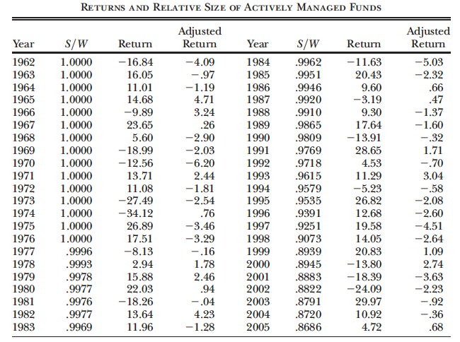
Prior & posterior belief - data

Slide 18
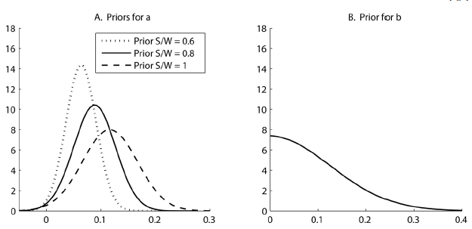
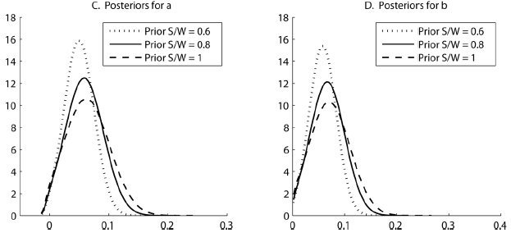
Prior & posterior belief - Comparison

Slide 19
Prior & posterior belief - posterior
After updating our beliefs, we find the distributions of a and b shift to the left, indicating a downward revision in our beliefs.
The posterior mean for a is 0.06, which is below the prior mean of 0.09, and the posterior mean for b is 0.07, below the prior mean of 0.1.
While the posteriors are naturally tighter than the priors, they remain quite disperse. Investors clearly remain substantially uncertain about a and b even after observing 44 years of data.

Slide 20
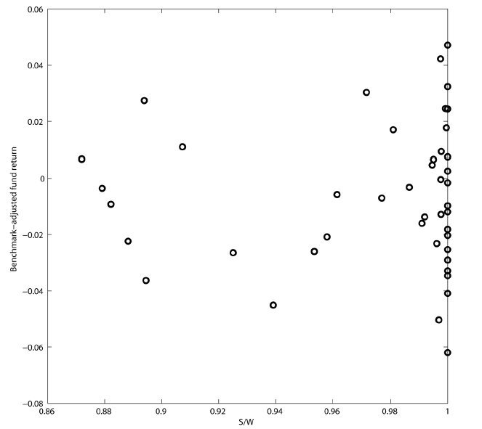
Prior & posterior belief – Comparison

Slide 21
Future size of active management industry - methodology
Assess the expected future size of the active management industry conditional on a summary measure of the industry’s future record.
Assume the investors enter the future with beliefs about a and b consistent with the industry’s current size
Compute the expected future values of the equilibrium S/W for different values of t-statistic of the industry’s future estimated alpha

Slide 22
Future size of active management industry - Methodology
Simulate 300,000 samples of future returns on active funds.
Draw a and b randomly from their joint posterior distribution at the end of our 44 year sample
Draw the random values of x_{t} ~ N(0, σ_{x}²)for t =1,…20 years
Construct r_{A,1}=a-b(0.867)+x₁
Solve for new equilibrium allocation (S/W)₂ on the basis of updated belief
Construct r_{A,2}=a-b(S/W)₂+x₂ and repeat the above process
Calculate the t-statistic α√t/σ_{x。}

Slide 23
Future size of active management industry – expected size
Conditional on the t-statistic of 0, E(S/W)is roughly constant, declining from the current value of 86.7 percent to 86.2 percent after 20 years.
Conditional on the t-statistic of 2, E(S/W) rises to 92.2 percent after 20 years.
If the industry performs better than expected, it grows at the expense of passive investments, but its growth is restrained by decreasing returns to scale: investors know that when they allocate more to active management, their future returns will be lower. Because of this key mechanism, S/W is expected to vary slowly over time regardless of performance.

Slide 24
Future size of active management industry – expected size
Conditional on the t-statistic of -2, E(S/W) declines from 86.7 percent 63.4 percent after 20 years.
This striking result is due to decreasing returns to scale. Investors observing underperformance reduce their active allocation, but not as much as they would under constant returns to scale because they understand that when they allocate less to active management, their future active returns will be higher.

Slide 25
Future size of active management industry – learning speed
Investors’ learning about a and b is typically slow. For the median sample, the posterior standard deviations decline only modestly over the 20-year period: from 0.030 to 0.026 for a and from 0.031 to 0.028 for b.
Investors thus remain highly uncertain about a and b even after 20 additional years of learning. This result underscores the importance of incorporating uncertainty about a and b in assessing the size of the active management industry.

Slide 26
Future size of active management industry – learning speed
The reason the learning about a and b is slow is the endogeneity in the way investors learn: what they learn affects how much they invest, and how much they invest affects what they learn.
Fluctuations in S/W are muted by decreasing returns to scale. The resulting stability of S/W hampers learning about a and b. If the right-hand-side variable (S/W) in the regression does not fluctuate much, learning about the intercept and slope is slow.
At the extreme, if S/W stops fluctuating, learning about a and b stops as well. In that case, investors would eventually learn the true value of a at the prevailing level of S/W, but they would never learn a and b, so they would forever remain uncertain about a at any other level of S/W.

Slide 27
Conclusion
The paper use a model with competing investors and fund managers to find that the large observed size of the active management industry can be rationalized if investors believe that active managers face decreasing returns to scale.
Under constant return to scale, investors will allocate nothing to active management.
Under decreasing return to scale, investors will adjust their allocation to active management, but it should also remain substantial.
Active management industry is likely to remain large for many more years, even if it continues to underperform.

Slide 28
conclusion
Investors in our model face endogeneity that limits their learning: what they learn affects how much they allocate to active management, and what they allocate affects how much they learn.
Owing to this endogeneity, the equilibrium allocation tends to vary little over time, resulting in slow learning about the degree of returns to scale in active management.
Initial beliefs about returns to scale thus affect the investors’ active allocations for a long time.

